Slide 1


Docker for R
(Rocker)
Katie Hoffman

Slide 2
Some common problems
(aka “Why Rocker?”)
Have you ever needed to have someone run your code, but they didn’t have the correct version of R or package dependencies?
Have you ever wanted to run code, but the package that you used 3 years and 5 updates ago doesn’t work?
Is your code taking too much time to run and
you’d like to run it on a remote server?
You can use Rocker!

Slide 3
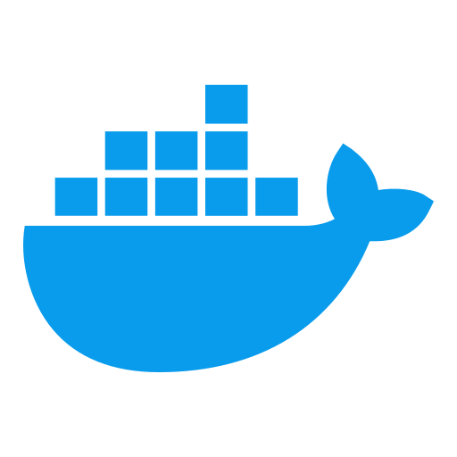
What is Docker?
What is Rocker?
Important Terminology
Container: a virtual environment with all of the operating systems required for your code
Image: the instructions to build a docker container (rocker/geospatial)
Dockerfile: the instructions required to build a docker image
A docker container that is already versioned for R
You can run:
Any version of R* with
rocker/r-ver
rocker/rstudio
rocker/verse
rocker/tidyverse
rocker/geospatial
*I’m not entirely sure about geospatial, but for sure after version 4.0.0
Notes:
The dockerfile contains the commands to build an image. It is a text file that can be read from top to bottom (like normal). The image is the instructions run in the terminal to build the docker container. The docker container is a virtual environment with all of the operating systems required to run YOUR code. r-ver version-stable base R & src build tools 219 MB 6,000 rstudio adds rstudio 334 MB tidyverse adds tidyverse & devtools 656 MB 1 verse adds java, tex & publishing-related packages 947 MB geospatial adds geospatial libraries 1.3 GB

Slide 4
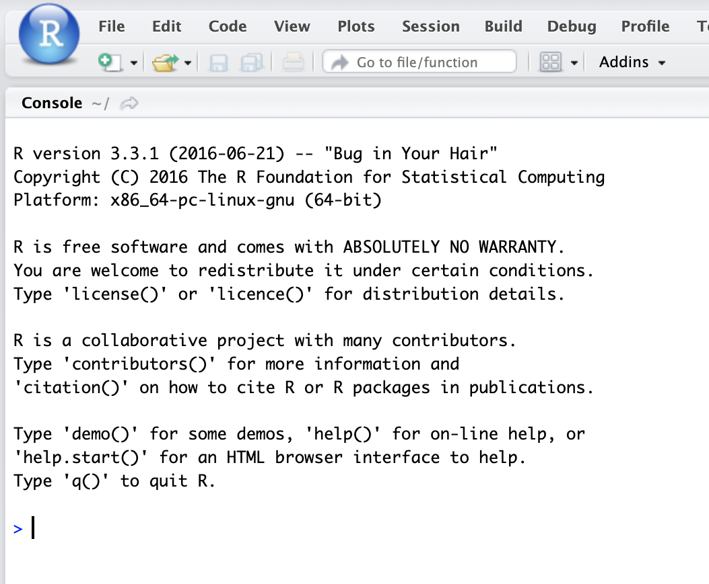
How do we use Docker for R?
Install Docker
Run in your terminal:
docker run --rm -ti -e PASSWORD=yourpassword -p 8787:8787 rocker/rstudio:3.3.1
docker run use docker and run it
--rm remove the container when you’re done with it
-ti specifies the terminal (t) and interactive (i) flags
-e sets the environment variable, see below
-e PASSWORD=yourpassword assigns your login password as “yourpassword”
-p 8787:8787 tells you where to access the container (localhost:8787 in your browser)
rocker/geospatial tells it where to get the dockerfile to create the image
Notes:
(use whatever version you want here - this will use most current with geospatial packages pre-loaded)

Slide 5

Docker Demo

Slide 6
Resources to set up Docker/Rocker
Github Repo for rocker images >= 4.0.0
Github Repo for rocker images < 4.0.0
An Introduction to Rocker: Docker Containers for R (Boettiger and Eddelbeuttel)
Docker Overview: Docker Getting Started Homepage
To install Docker, go here
*These are all for setting up to run a pre-made rocker container. If you want to set up your own container, Docker has some really great guides and tutorials, both within the app and here

